Slide 2
Introduction to Sequential Circuits
Inputs
Outputs
Combina-tional
Logic
A Sequential circuit contains:
Storage elements: Latches or Flip-Flops
Combinational Logic:
Implements a multiple-output switching function
Inputs are signals from the outside.
Outputs are signals to the outside.
Other inputs, State or Present State, are signals from storage elements.
The remaining outputs, Next State are inputs to storage elements.
Storage Elements
Next
State
State

Slide 3
Types of Sequential Circuits
Depends on the times at which:
storage elements observe their inputs, and
storage elements change their state
Synchronous
Behavior defined from knowledge of its signals at discrete instances of time
Storage elements observe inputs and can change state only in relation to a timing signal (clock pulses from a clock)
Asynchronous
Behavior defined from knowledge of inputs an any instant of time and the order in continuous time in which inputs change
If clock just regarded as another input, all circuits are asynchronous!
Nevertheless, the synchronous abstraction makes complex designs tractable!

Slide 4
Basic (NOR) S – R Latch
Cross-coupling two NOR gates gives the S – R Latch:
Which has the time sequence behavior:
R (reset)
Q
S (set)
Q
Time
R
S
Q
Q
Comment
0
0
?
?
Stored
0
1
1
0
“Set” Q to 1
0
0
1
0
Now Q “remembers” 1
1
0
0
1
“Reset” Q to 0
0
0
0
1
Now Q “remembers” 0
1
1
0
0
Both go low
0
0
?
?
Unstable!

Slide 5
Basic (NAND) S – R Latch
“Cross-Coupling” two NAND gates gives the S -R Latch:
Which has the time sequence behavior:
S = 0, R = 0 is forbidden as input pattern
S (set)
Q
Q
R (reset)
Time
R
S
Q
Q
Comment
1
1
?
?
Stored
1
0
1
0
“Set” Q to 1
1
1
1
0
Now Q “remembers” 1
0
1
0
1
“Reset” Q to 0
1
1
0
1
Now Q “remembers” 0
0
0
1
1
Forbidden
1
1
?
?
Unstable!

Slide 6
Clocked S - R Latch
Adding two NAND gates to the basic S - R NAND latch gives the clocked S – R latch:
Has a time sequence behavior similar to the basic S-R latch except that the S and R inputs are only observed when the line C is high.
C means “control” or “clock”.
S
Q
C
Q
R

Slide 7
Clocked S - R Latch (continued)
The Clocked S-R Latch can be described by a table:
The table describes what happens after the clock [at time (t+1)] based on:
current inputs (S,R) and
current state Q(t).
S
Q
C
Q
R

Slide 8
D Latch
Adding an inverter to the S-R Latch, gives the D Latch:
Note that there are no “indeterminate” states!
D
Q
C
Q
forbidden
Q
D
Q(t+1)
Comment
0
0
0
No change
D
Q
0
1
1
Set Q
1
0
0
Clear Q
C
Q
1
1
1
No Change

Slide 9
Edge-Triggered D Flip-Flop
The edge-triggered D flip-flop is the same as the master- slave D flip-flop
It can be formed by:
Replacing the first clocked S-R latch with a clocked D latch or
Adding a D input and inverter to a master-slave S-R flip-flop
The delay of the S-R master-slave flip-flop can be avoided since the 1s-catching behavior is not present with D replacing S and R inputs
The change of the D flip-flop output is associated with the negative edge at the end of the pulse
It is called a negative-edge triggered flip-flop
D
D
Q
S
Q
Q
C
C
C
Q
R
Q
Q

Slide 10
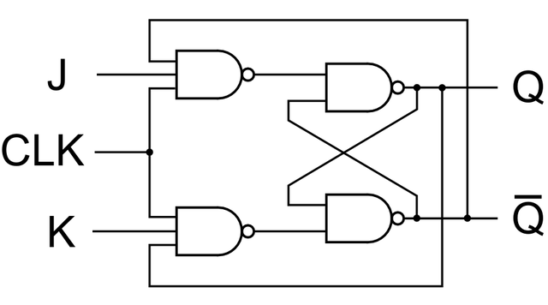
J-K Flip-flop (continued)
Implementation
To avoid 1s catching behavior, one solution used is to use an edge-triggered D as the core of the flip-flop
Symbol
J
C
K
J
D
K
C

Slide 11
T Flip-flop (continued)
Implementation
To avoid 1s catching behavior, one solution used is to use an edge-triggered D as the core of the flip-flop
Symbol
T
C
D
T
C

Slide 12
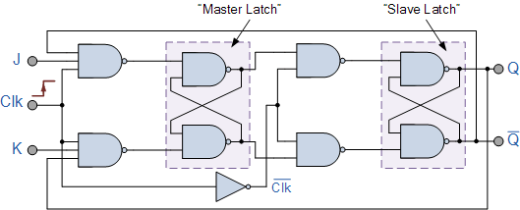
Master Slave Flip flop

Slide 13
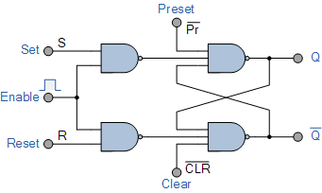
Clear Preset

Slide 14
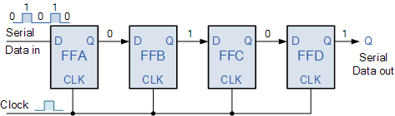
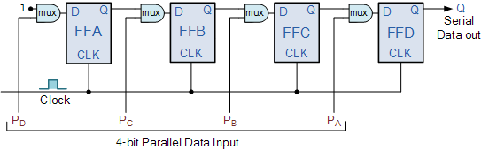
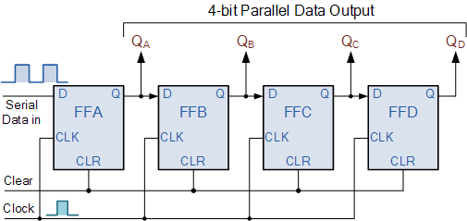
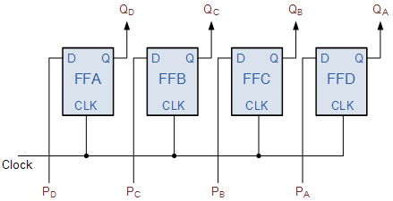
Register

Slide 16
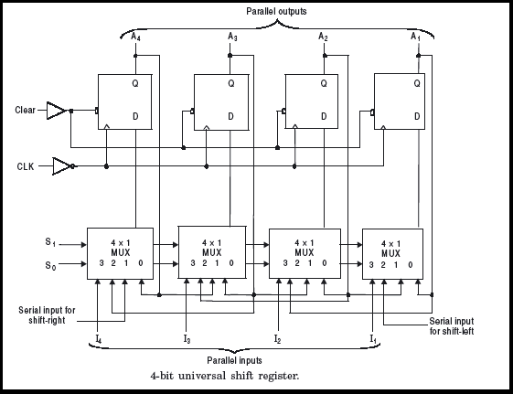
Universal Register

Slide 17
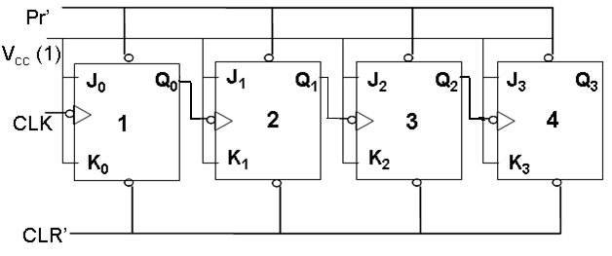
Asynchronous counter

Slide 18
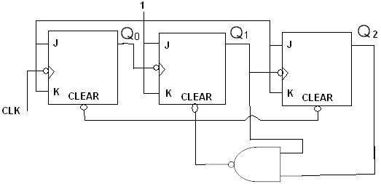
Mod- ?

Slide 19
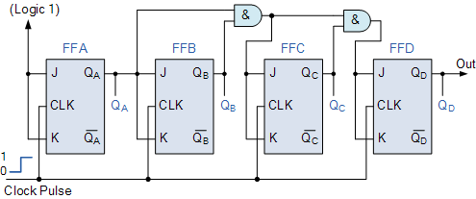
Synchronous counter

Slide 20
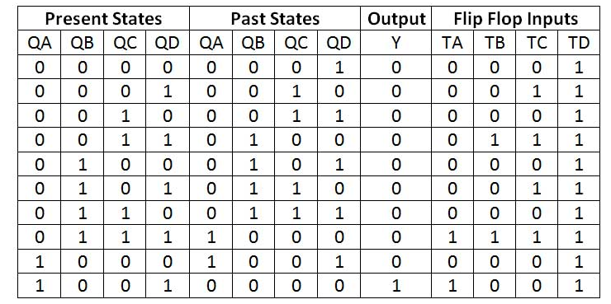
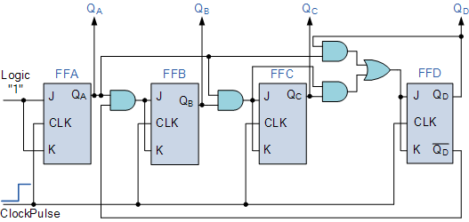
BCD synchronous counter

Slide 21
Moore and Mealy Example Diagrams
Mealy Model State Diagram maps inputs and state to outputs
Moore Model State Diagram maps states to outputs
x=1/y=0
x=0/y=0
0
1
x=0/y=0
x=1/y=1
x=0
0/0
x=0
x=1
x=1
x=0
1/0
2/1
x=1

Slide 22
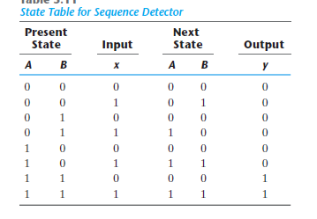
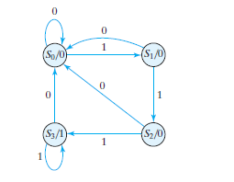
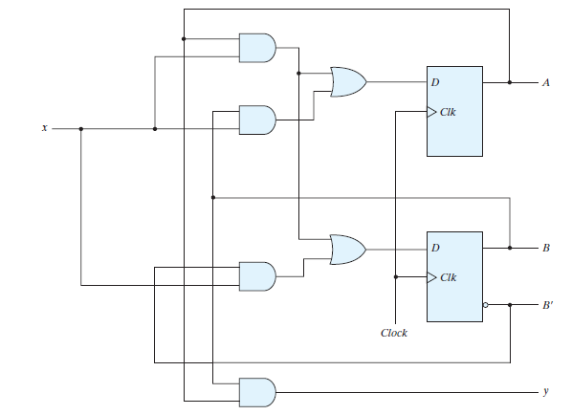
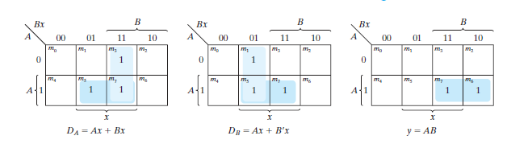
Using D-FF

Slide 23
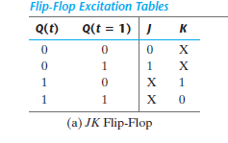
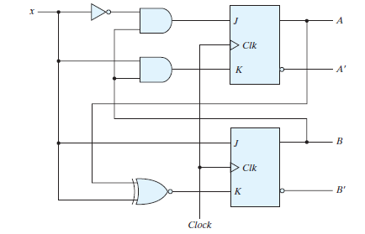
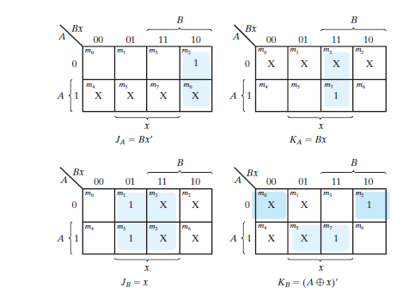
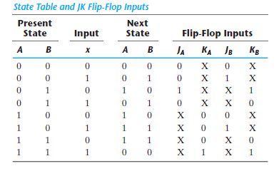
Design Using J-K

